Slide 1

Data Structures and Algorithms
Notes, Greedy Algorithms

Slide 2
Greedy Algorithms
A greedy algorithm is one in which you make the locally optimal move at any point in the program without looking more than one step ahead.
Example:
If I want to go someplace due east, whenever I come to an intersection I look at the compass and take the most easterly path, street, or road.

Slide 3
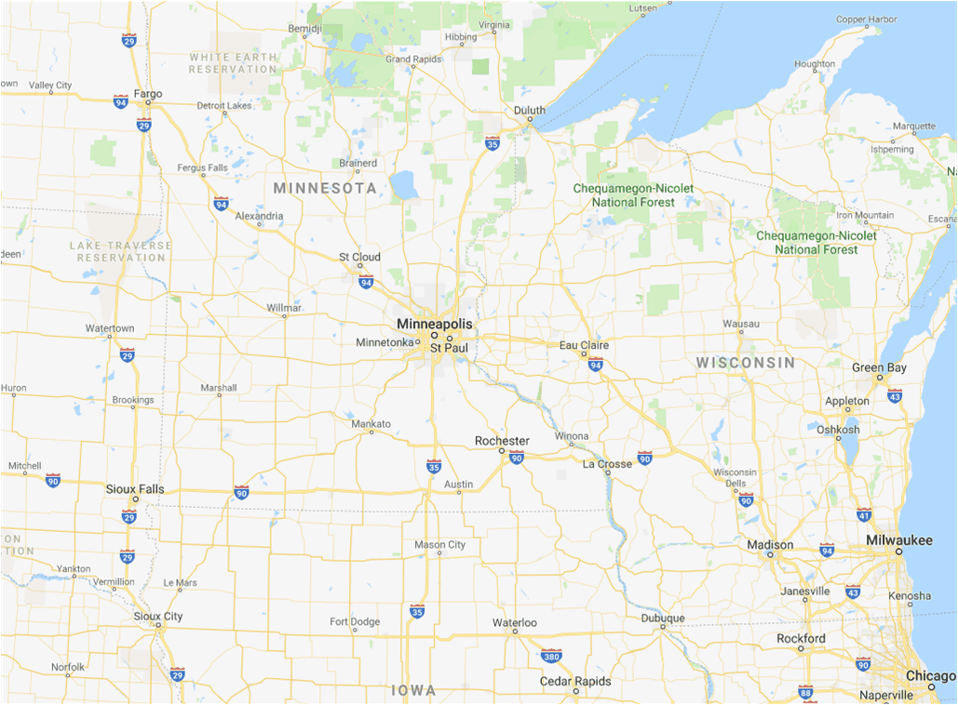


Minneapolis → Chicago

Slide 4
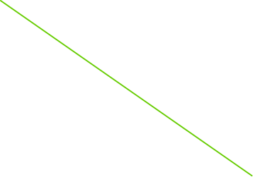
Minneapolis → Chicago

Slide 5
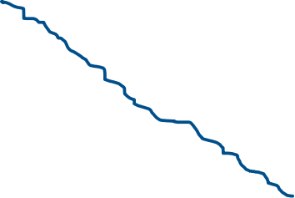
Minneapolis → Chicago

Slide 6
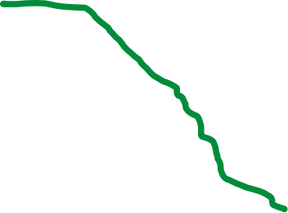
Minneapolis → Chicago

Slide 7
How Good Are They?
Sometimes Greedy algorithms can actually give optimal solutions to problems
Fractional knapsack problem (later today)
Some graph problems (next few weeks)
Other times they make for good, quick, sub-optimal solutions
Greedy set cover
Other times they are terrible
The navigation algorithm from the last page

Slide 8
When Do They Work?
For a problem to yield to a greedy strategy (optimal solution), it must have two properties:
Optimal Substructure: The optimal solution to the problem contains the optimal solutions to subproblems
Exactly the same as in Dynamic Programming
Greedy Choice Property: A globally optimal solution can be found by making the locally optimal step at any time.
No general rule of thumb for this, although matroid theory (out of scope for this class) can be helpful
Notes:
Do IC 0

Slide 9
How to Create a Greedy Algorithm
Design an algorithm in which you make a locally optimal (greedy) choice, and leave yourself with one subproblem to solve.
Show that there is a globally optimal solution to the problem that makes the greedy choice.
Show that after making the greedy choice, an optimal solution to the whole problem contains an optimal solution to the one remaining subproblem.

Slide 10
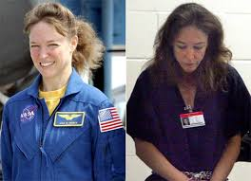
The Strange Case of Lisa Nowak
She drove to Cape Canaveral to beat up her love rival.
She loaded up her car with food and water, and wore an adult diaper.
She wanted to minimize the number of stops she made for gas.
What is the optimal algorithm to do this?
While in Houston, former NASA astronaut Lisa Nowak found out her boyfriend in Florida was fooling around.

Slide 11
Greedy Algorithm (with argument)
Drive as far as you can without running out of gas (greedy choice), call the farthest gas station g. This leaves you the subproblem of getting from gas station g to the Cape in as few stops as possible.
The greedy choice is part of some optimal solution. Any other choice leaves you a longer drive after the first gas stop, so drive as far as possible.
Clearly, to minimize the number of stops overall given the first gas stop is at station g, you want to minimize the number of stops from g to the Cape.

Slide 12
Harder Example: Activity Selection
Select the maximum number of activities that can fit in a room based on their scheduled start and stop times.
Can be solved with a greedy algorithm, or a dynamic programming algorithm.
Let’s do the dynamic programming algorithm first, it’s a good, simple example.

Slide 13
Activity Selection: Optimal Substructure
This problem has optimal substructure:
If we know that one certain activity a_{k} is part of the solution, the optimal solution to the scheduling problem will contain the optimal solution to the problem of scheduling the rest of the activities into the time that the room is not being used by activity a_{k}.
The optimal solution must contain a subset A_{0,k-1} of activities ending before a_{k} starts.
If that subset were not optimal (maximal number of activities), we could replace A_{0,k-1} with the optimal subset, and have a better answer.
Same argument holds for activities starting after a_{k} ends.
Notes:
Do IC 1

Slide 14
Activity Selection: Dynamic Programming
Suppose that we know that activities a_{i} and a_{j} are in the optimal set.
This is a good way to start because if there are n items, we can define two special activities:
a₀ is the activity that ends when the first real activity starts
a_{n+1} is the activity that starts when the last real activity ends.
Then any optimal solution will have both a₀ and a_{n+1}.

Slide 15
Activity Selection: Dynamic Programming
Then let A_{ij} be the optimal set of activities that occur between the end of a_{i} and the start of a_{j} (given that both a_{i} and a_{j} are in the optimal solution).
A_{ij} contains some activity a_{k} (unless it is empty).
Let c[i,j] be the size of A_{ij}.
Because of optimal substructure, we can divide A_{ij} into the union of three parts:
A_{ij} = A_{ik} ∪ {a_{k}} ∪ A_{kj}. So c[i,j] = c[i,k] + c[k,j] + 1. So

Slide 16
Activity Selection: Greedy Algorithm
Select the maximum number of activities that can fit in a room based on their scheduled start and stop times.
Pick the activity a that finishes the earliest.
This is the greedy choice.
Put that activity a into the room.
Claim: The optimal schedule contains activity a.
Notes:
Quiz question 6

Slide 17
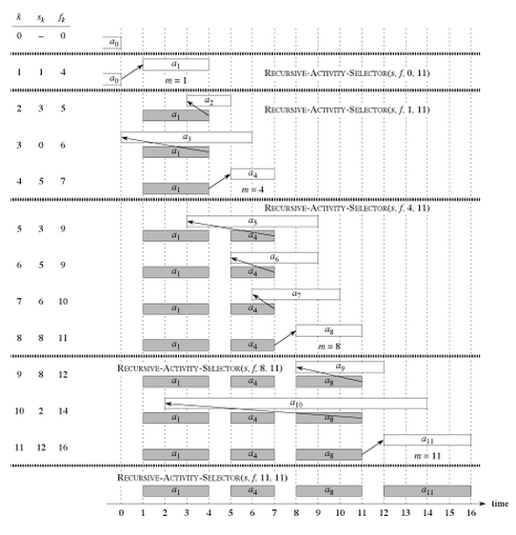
Activity Selection Example

Slide 18
Activity Selection: Greedy Choice
Claim: An optimal schedule contains activity a.
We argue Greedy Choice
Already showed optimal substructure
Greedy Choice (proof outline):
Suppose some optimal schedule doesn’t contain activity a.
Call the first activity to finish in this optimal schedule “b”.
b finishes after a, so we can replace b in the optimal schedule with a and we still have an optimal schedule.

